Slide 1
Apache Spark
Programming in Parallel Environment

Slide 2

Spark
Apache Spark
Unified analytics engine for large-scale data processing
Initial release 2014, newest Spark 4.0 was released 2025
Speed
Much faster than Hadoop
Ease of use
Write applications in Java, Python, R, and Scala
Interactive shell
Generality
Combine streaming, ML, SQL, and (data) analytics
Runs “everywhere”
Spark runs on Hadoop, Mesos, Kubernetes, standalone, or in a cloud
We will be using Spark 3.5

Slide 3
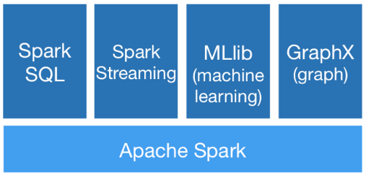
Spark
Contains
High-level API in Java, Python, R, and Scala
Optimized engine for general execution graph
DAG
MapReduce with only 2 levels
High-level tools
SparkSQL
MLlib
Spark Streaming
GraphX

Slide 4
Spark Application
Application
An independent set of processes on a cluster
+ isolation
- no shared data (except file storage)
Driver program
Main (controlling) script
Listen for incoming connections from executors (via network)
Coordinated by SparkContex object
Schedules tasks to executors
Has a web UI, handles storage
Cluster manager
Allocate resources across applications
Executor
Runs on nodes of the cluster
Executes computations and stores (caches) data
Stays up for the duration of the application
Runs tasks (possibly) in multiple threads

Slide 5
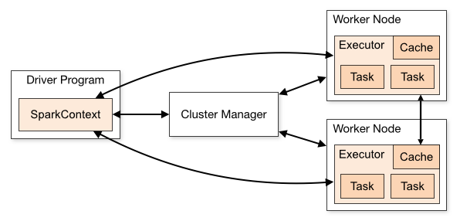
Spark Application Structure
App structure
The programmer creates a SparkContext object
It connects to the cluster manager(s)
Acquires executors from cluster manager(s)
Sends your application code to the executors
Pass Java/Python code/files to the SparkContext
Sends tasks to the executors
Including necessary data which can be partitioned and cached at the executors

Slide 6
Spark Cluster
Cluster managers
Spark is agnostic to the underlying cluster manager
Supported cluster managers
Standalone
Simple CM, which is included in Spark (easy to set up a cluster)
Apache Mesos
General CM can run Hadoop MapReduce and service applications
Hadoop YARN
Resource manager in Hadoop 2
Kubernetes
Automated deployment, scaling, and management of containerized applications
This is what we will use (with a custom sbatch script)

Slide 7
Spark Programming
Fundamentals
Working with larger datasets (collections/tables)
Text files, CSV, HDF5, …
Creating “pipelines” that process the dataset and yield a result
Emphasis on declarative approach (like SQL)
Distributed processing, little control over the low-level details
Except for partitioning (how the data are divided into chunks)
Lazy evaluation
Most operations are triggered once the data are really needed
Strongly oriented on data (pre)processing and analysis
For example, PySpark natively supports pandas data types

Slide 8
Data Holders
Resilient distributed dataset (RDD)
Immutable collection of elements
Partitioned across the nodes that can be processed in parallel
Possibly in-memory
Automatically recover from node failures
Core API, from initial release, all languages
Dataset
Distributed collection of data
Since v1.6, only for Java and Scala
Strong typing + lambdas from RDD
Using Spark SQL optimized execution engine
DataFrame
Like a Dataset, but organized into named columns
Since v1.3, all languages
Similar to a table in relational DB

Slide 9
Resilient Distributed Datasets (RDD)
Created in the driver program
sc = SparkContext()
distData = sc.parallelize(data)
distFile = sc.textFile("data.txt")
Datasets are immutable
Transformations
Each transformation takes an RDD and produces a new RDD
Lazy evaluation, aggregation, and automated distribution of tasks
An RDD can be cached or persisted on request to improve performance
Actions
Usually at the end, since they trigger evaluation
Used to get the result (back in the driver) or save it in a file
Creating RDD from memory (list)
… and from a data file

Slide 10
RDD Transformations
map(fnc), flatMap(fnc) | applies transformation on each element (flatMap can produce 0 or more elements)
filter(fnc) | only elements that pass the given predicate are included in the new dataset
union(data) | combines two datasets in union
intersection(data) | returns the intersection of this and given data set
distinct() | returns only distinct (unique) elements in the dataset
groupByKey() | takes pairs (K,V) and produces pairs (K, iter<V>) where values are grouped
reduceByKey(fnc) | similar to group-by, but also reduces values by given function
sortByKey(asc) | takes pairs (K,V) and sorts them by K (must implement Ordered)
join(data) | pairs (K,V) are joined with data (K,W) and (K,(V,W)) collection is returned
cartesian(data) | for data U and V produces all combinations of (U,V) pairs
coalesce(numP), repartition(numP) | change the number of partitions and redistribute data among them (e.g., coalesce is useful when a new dataset with significantly less elements is produced)
Notes:
https://spark.apache.org/docs/latest/rdd-programming-guide.html#transformations

Slide 11
RDD Actions
collect() | returns the elements of the dataset (materialization)
count() | computes the number of elements in the collection
first() | returns the first element in the collection
take(n) | returns the first n elements in the collection
reduce(fnc) | performs reduction using given function and returns the result
takeOrdered(n) | like take(), but performs partial sorting (basically a top-k selection)
saveAsXXX() | save the collection in the given format to a file (e.g., saveAsTextFile)
countByKey() | for collection of pairs (K,V) yields (K, count-of-values)
foreach(fnc) | Iterates over the collection, invoking fnc (which usually has side effects, but runs on workers!)
Note that actions are executed on the workers. I.e, any side effects (like print) also take place there (so .foreach(print) is not going to work as expected)
Notes:
https://spark.apache.org/docs/latest/rdd-programming-guide.html#actions

Slide 12
RDD Example
Example
Counting words in a (large) text file
from pyspark import SparkContext
sc = SparkContext()
file = sc.textFile("wiki.txt")
words = file.map(lambda line: len(line.split())) \
.reduce(lambda x, y: x + y)
print(words)

Slide 13
Functions and Shared Variables
Functions (used in transformations/actions)
Executed on the workers
The whole closure is transferred from the driver app
No side effects, except for updating shared variables
Shared variables
Broadcast brVar = sc.broadcast(data)
Cached read-only variable, optimizes driver->worker transfers + provides cache control
Tasks can read it by calling the value() function
Accumulator acc = sc.accumulator(baseVar)
Worker tasks can call add(v) operation (accumulate a value)
Only the driver can read the accumulator by calling the value() function
Typically a number, but can be a custom class that defines its own “add” operation
Notes:
https://spark.apache.org/docs/latest/rdd-programming-guide.html#shared-variables

Slide 14
DataFrame
DataFrame
A distributed dataset (like RDD) but organized as a table (like in SQL databases)
Row-wise partitioning (selection of rows, all columns)
Construction
spark = SparkSession.builder.getOrCreate()
df = spark.createDataFrame([ Row(col1=42, col2='the answer’) ]
csv_df = spark.read.csv('foo.csv', header=True)
pd_df = pandas.DataFrame({ … })
Many other possibilities: external DB, existing RDD, tables from Hadoop…
Transformations and actions similar to RDD
Lazy evaluation, SQL-like operations

Slide 15
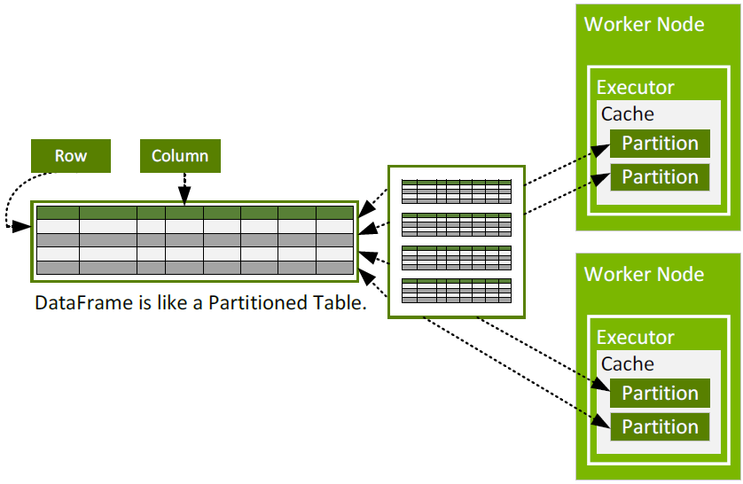
DataFrame Partitioning

Slide 16
DataFrame
Inspecting the data
df.show(n) – prints the table (or first n rows)
df.printSchema() – prints the column names and types
df.columns – access the column names as a list
df.describe().show() – get basic statistics (count, min, max…) per col.
Accessing/saving the data
df.collect()
df.take(n)
df.toPandas()
df.write.csv(file, header)

Slide 17
DataFrame
Transformations
All yield a new DataFrame (lazily evaluated)
df.colName – returns column object (metadata)
df.select(df.col1, "col2") – selects a set of columns (projection)
df.filter(df.c == 42) – filter rows using a condition (like SQL WHERE)
df.withColumn(name, fnc) – add new column
Values are computed from the other columns
df.groupBy(col) – groups using specified column(s)
Aggregate functions can be applied on the rest (.avg(), .count(), …)
df.join(df2, on) – join with another DataFrame using the on join expr.

Slide 18
DataFrame Example
Example
spark = SparkSession.builder.getOrCreate()
df = spark.read.csv("employees.csv", header=True)
sel_df = df.select("department", "salary")
fil_df = sel_df.filter(sel_df.salary > 50000)
grp_df = fil_df.groupBy("department")
.avg("salary").alias("average_salary")
grp_df.show()

Slide 19
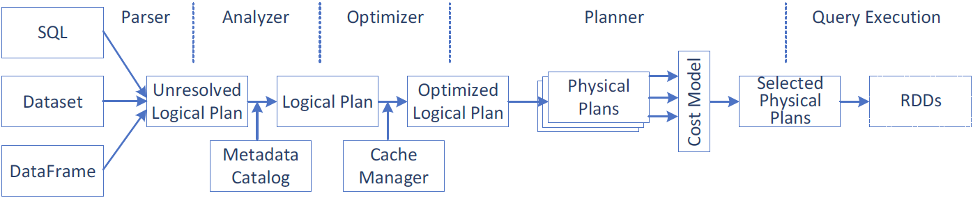
Spark Query Execution
Query execution steps
Create a logical plan
Transform the logical plan into a physical plan
Generate the code
Execute the tasks on a cluster

Slide 20
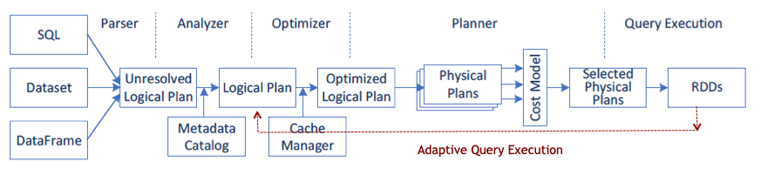
Advanced Spark 3.x Features
Adaptive Query Execution (AQE)
Runtime statistics retrieved from completed stages of the query plan are used to re-optimize the execution plan
Dynamically coalescing shuffle partitions
Combine adjacent small partitions into bigger partitions, reducing the number of tasks
Dynamically switching join strategies
Optimize join strategy at runtime based on the join relation size
Dynamically optimizing skew joins
Detect data skew and split skew partitions into smaller sub-partitions

Slide 21
Advanced Spark 3.x Features
Dynamic partition pruning
Data warehouse queries
One or more fact tables referencing any number of dimensional tables
Pruning at runtime by reusing the dimension table broadcast results in hash joins
Accelerator-aware scheduling
GPU/CUDA with RAPIDS

Slide 22
Launching Spark Application
Runtime (Spark + Hadoop)
Self contained in one directory (we denote SPARK_ROOT): /home/_teaching/para/spark
Starting interactive shell (in Python)
SPARK_ROOT/bin/pyspark
Standalone applications (debugging)
SPARK_ROOT/bin/spark-submit ./yourSparkApp.py
--master URL of the master node for the cluster
local[k] – run locally with k worker threads (with one thread if [k] is missing)
local[*] – run locally with max number of worker threads (=cores, use `-c` in srun)
spark://HOST:PORT – run on a standalone Spark cluster master
CM://HOST:PORT – connect to a cluster manager [mesos, yarn, k8s]
--class entry point for the application (no need for top-level statement scripts)
Please, do not do this on parlab since interactive sessions block workers for a long time

Slide 23
Launching Spark Cluster
Submitting to a standalone cluster with simple CM
Start the master
Start the workers, and make them connect to the master
Use spark-submit with the master from 1.
Prepared script spark-slurm.sh
A sbatch script that performs all aforementioned tasks $> sbatch ./spark-slurm.sh ./yourSparkApp.py
Creates ./slurm-<JOBID>.spark subdir with configs and logs
Directs stdout and stderr into ./spark-slurm-* files in local dir
Executes 2 workers per node (i.e., 1 per socket)
You can tune the #SBATCH -N parameter to select the number of nodes (up to 8)

Slide 24

Discussion

